Slide 1
Business intelligence
Global Competitiveness Data Analysis
Tunisia Data Analysis
Rihem Maaref
Notes:
https://pixabay.com/en/seminar-lecture-study-student-2654142/

Slide 2
Methodology
Introduction
Conclusion and perspectives
Tools and Algorithms
Analysis and Estimations
Comparison

Slide 3
Lack and lower Points
01
Introduction
Business intelligence : descriptive analysis

Slide 4
Tools and Algorithms
02
The Global Competitiveness Report 2019 and 2009
MatPlotLib
Linear Regression Algorithm

Slide 5
Analysis and Estimations
Tunisia
03
Selected Country:

Slide 6
index 1
index 2
index 3
Index 02
45%
Indexes

Slide 7
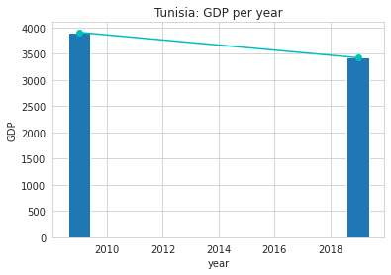
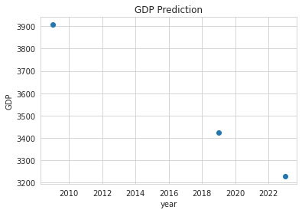
Index:
GDP
Analysis
Estimation
3907
3423
3229
484 $

Slide 8
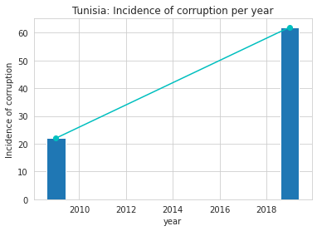
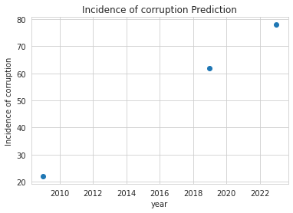
Index:
Incidence of corruption
Analysis
Estimation
62
78
22

Slide 9
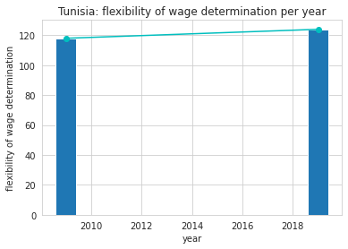
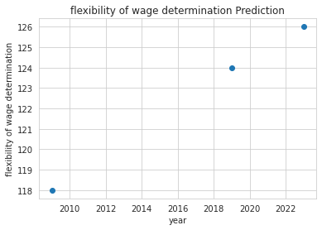
Index:
Flexibility of wage determination
Analysis
Estimation
126
118
124

Slide 10
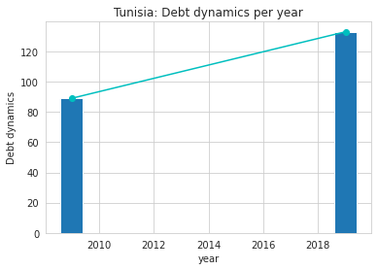
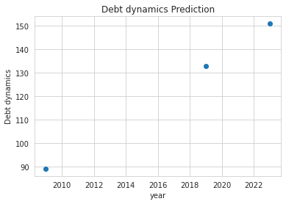
Index:
Debt dynamics
Analysis
Estimation
133
151
89

Slide 11
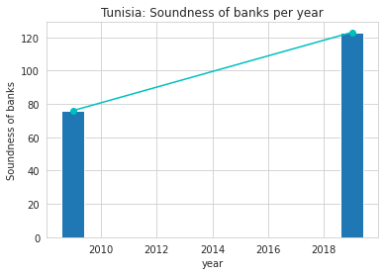
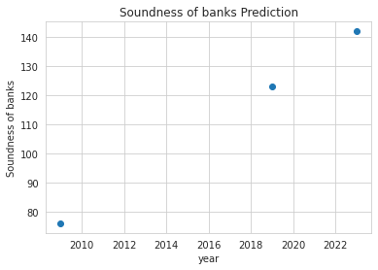
Index:
Soundness of banks
Analysis
Estimation
123
142
70

Slide 12
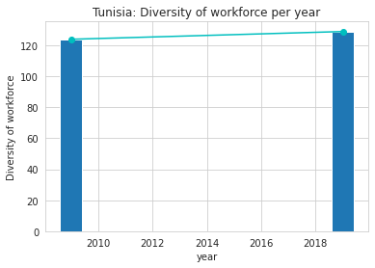
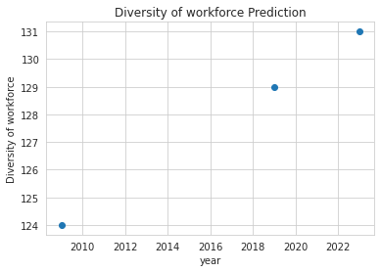
Index:
Diversity of workforce
Analysis
Estimation
124
129
131

Slide 13
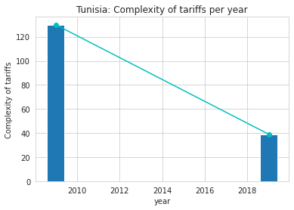
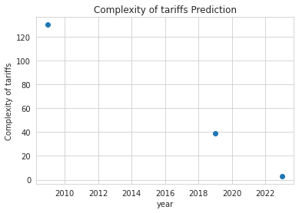
Index:
Complexity of tariffs
Analysis
Estimation
130
39
3

Slide 14
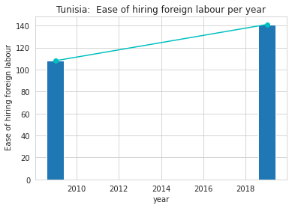
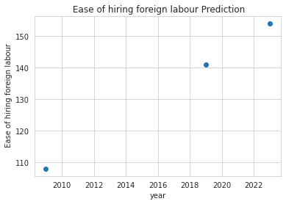
Index:
Ease of hiring foreign labour
Analysis
Estimation
154
108
141

Slide 15
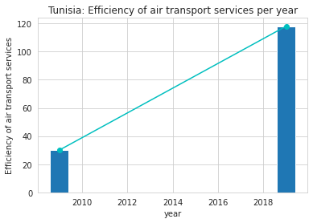
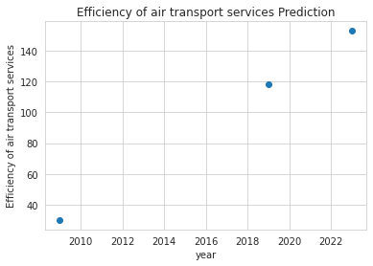
Index:
Efficiency of air transport services
Analysis
Estimation
153
118
30

Slide 16
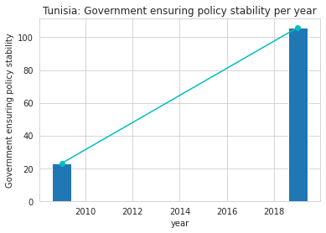
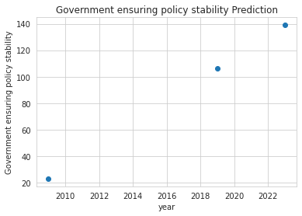
Index:
Government ensuring policy stability
Analysis
Estimation
140
106
23

Slide 17
Comparison
04
France
Turkey
Tunisia
Algeria

Slide 18
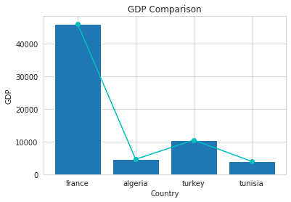

Index:
GDP (2019)
2009
2019
- 3138 $
- 1132 $
46,015
- 351 $
42,877
10477
- 484 $
9345
4588
3907
4237
3423

Slide 19
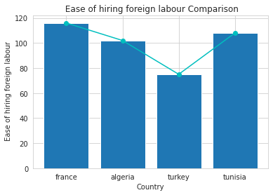
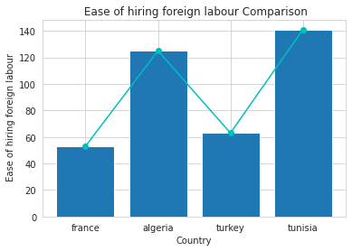
Index:
Ease of hiring foreign labour
2009
2019
75
141
108
102
125
116
53
63

Slide 20
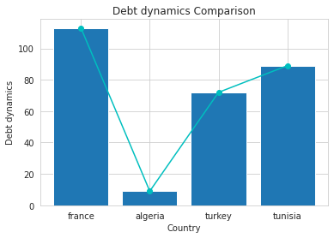
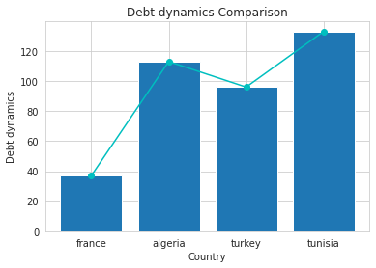
Index:
Debt dynamics
2009
2019
133
113
113
89
9
72
96
37

Slide 21
05
Conclusion
Rank
decrease
Time

Slide 22

Perspectives
Next 10 Years
GDP
Air Services

Slide 23
Thanks For Your Attention

